Slide 1
Tinnitus Triage Pathway
Send Tinnitus pack and TA invitation letter
If patient contacts department book TA appointment
PTA within the last 6 months
ENT/ GP/ Internal Referral received
Book Tinnitus PTA and include tinnitus pack with appointment letter
At PTA book further TA/ Fitting appointment as appropriate
No PTA
Tinnitus Pack includes the following BTA Leaflets:
All about Tinnitus
Sound Therapy
(Enrichment)

Slide 2
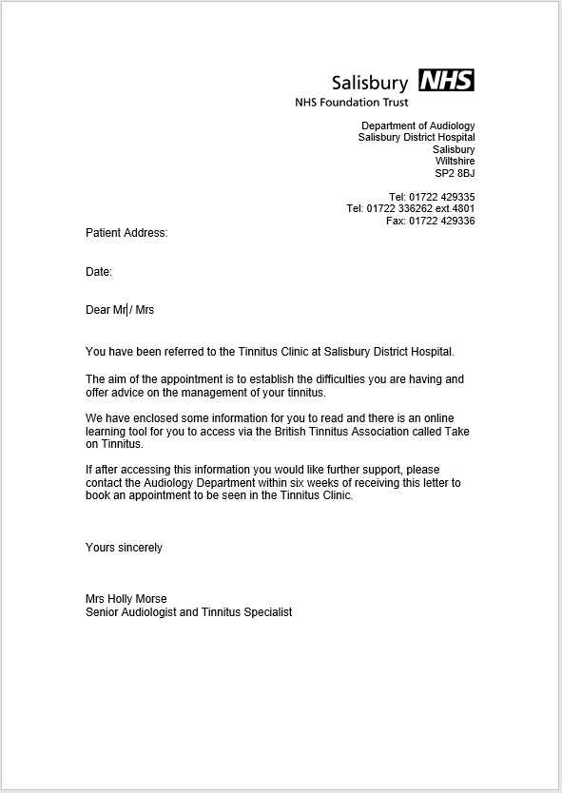
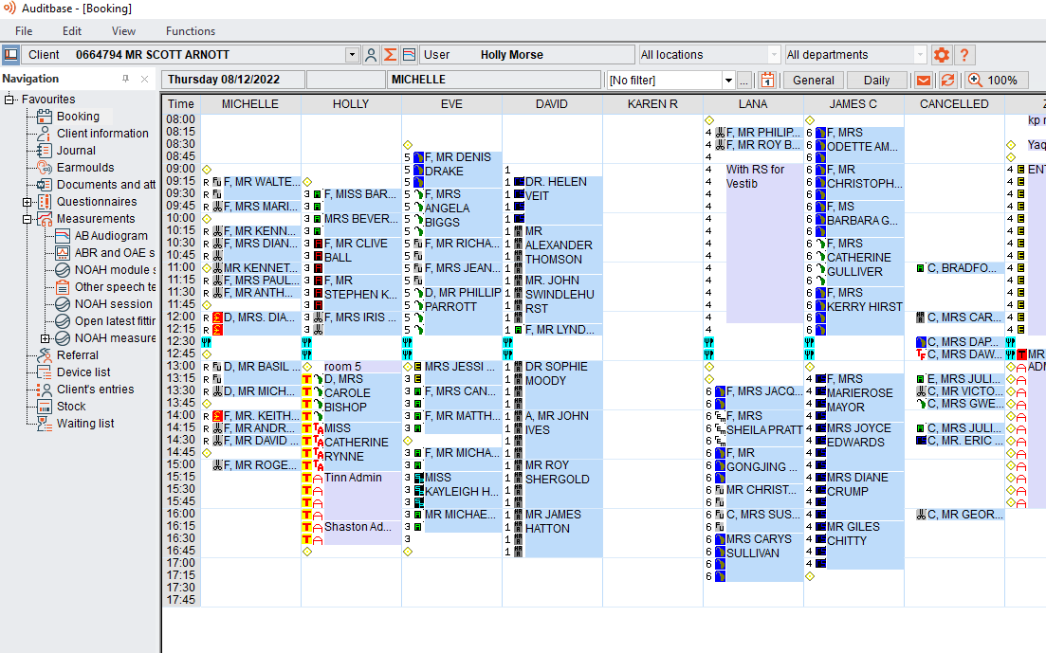
Appendix 1: TA invitation Letter
This is an amended version of the existing Tinnitus APPT letter on Auditbase, accessible from the letter symbol

Slide 3
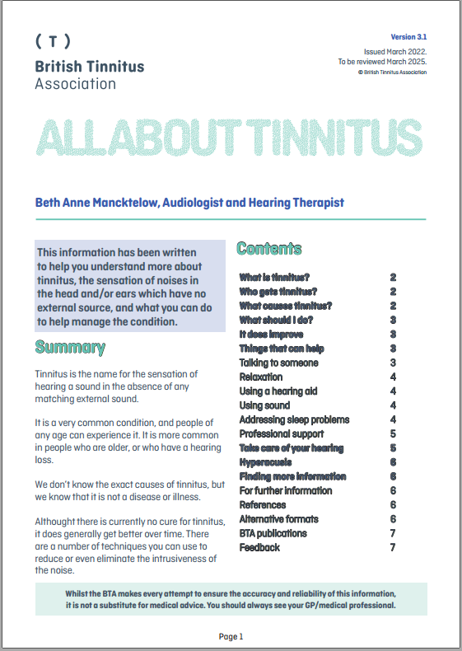
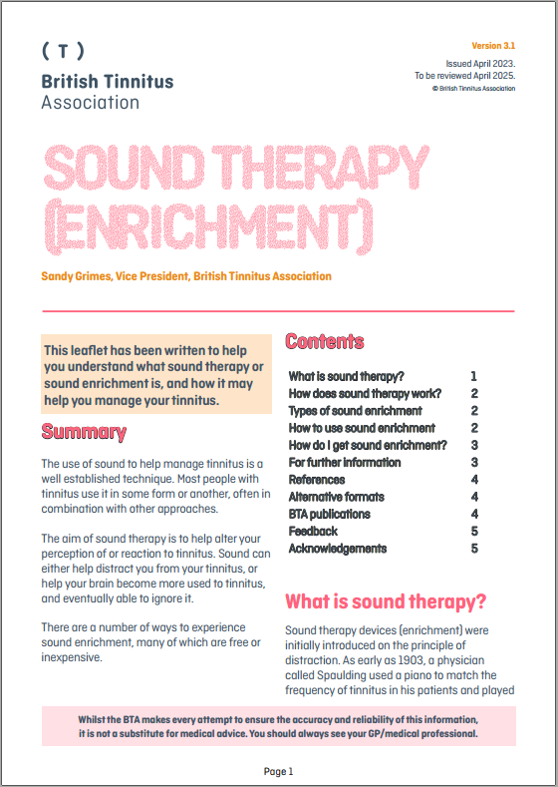
Appendix 2: Tinnitus Pack
Leaflet available on intranet Tinnitus folder or direct from BTA web links below:
All about tinnitus link to leaflet: https://www.tinnitus.org.uk/all-about-tinnitus
Sound enrichment link to leaflet: https://www.tinnitus.org.uk/sound-therapy

